Slide 1
Intro to
Machine Learning

Slide 2
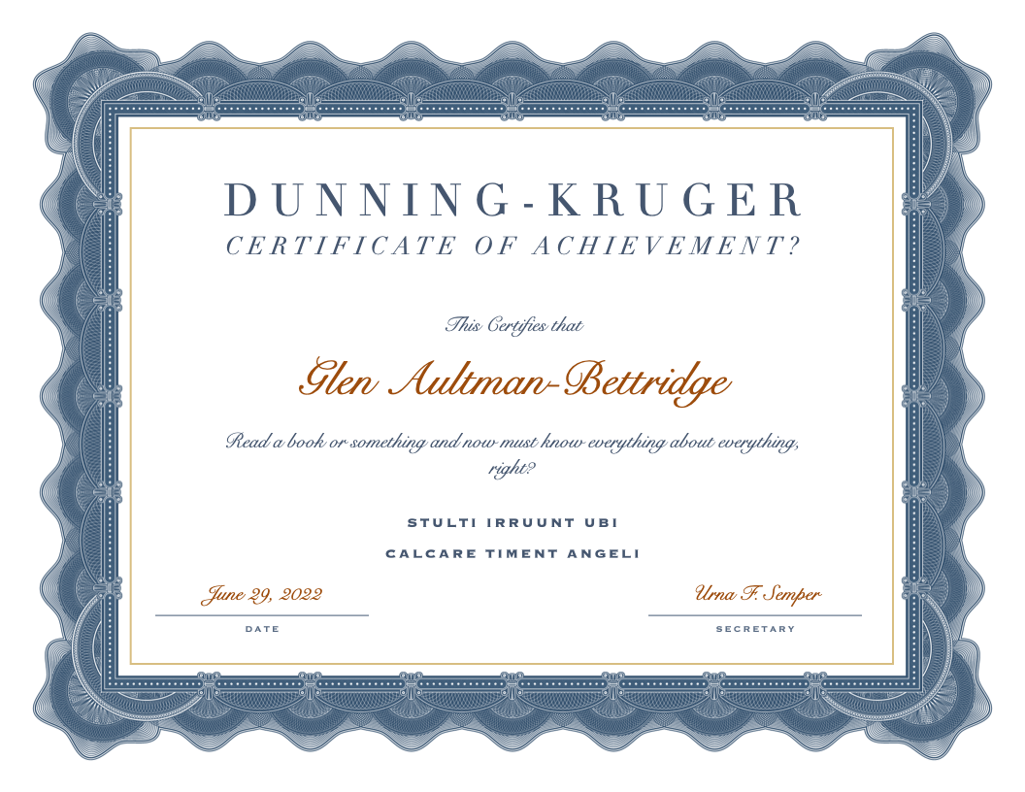
Fair Warning

Slide 3
Fair Warning(s)
Mathematical storms lie ahead! Interrupt if you have questions about math terms or ideas
There is a lot of nuance and tons of edge cases throughout machine learning. I’m planning to skip all of it, ’cause 30 minutes… but I’d rather spend the time discussing your questions if you want to explore nuances and edge cases.
I’m still learning so everything I’m about to say could be (and probably is) wrong. Please ask questions if something looks weird or suspicious!

Slide 4
Why learn machine learning?

Slide 5


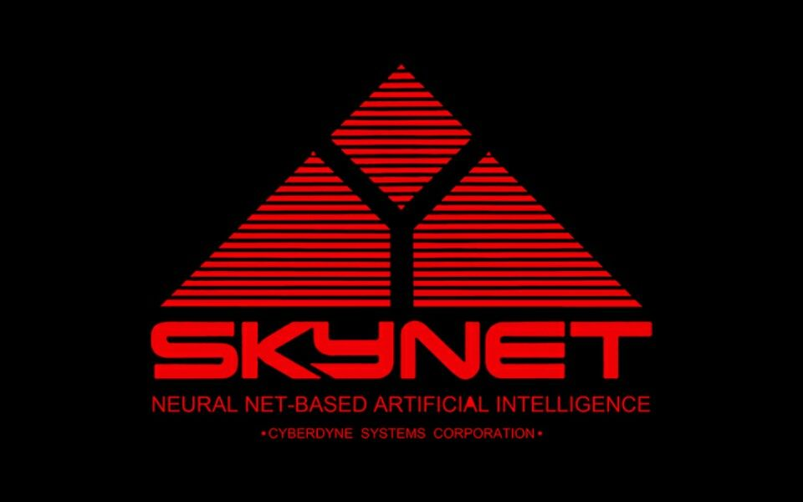
Because they can’t write themselves…
GLaDOS
…yet

Slide 6

Broad strokes, what is ML?

Slide 7
Broad strokes, what is ML?
Algorithms, based on mathematical models, which use sample data to generate software models that make pretty good predictions or classifications when handed input that looks like the samples.

Slide 8
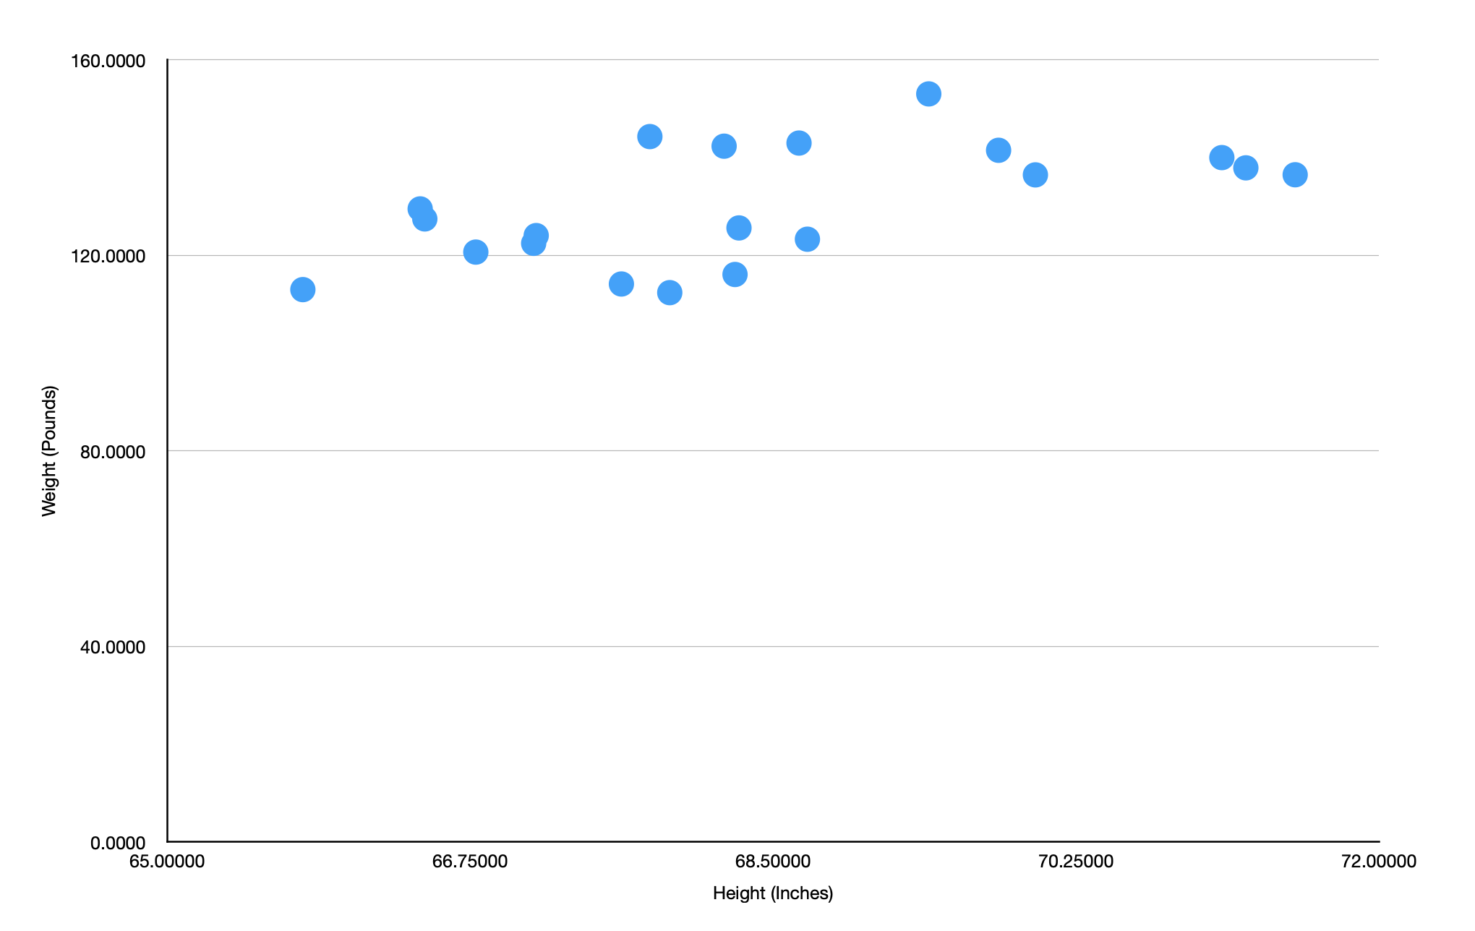
A prediction example

Slide 10
Mathy bit
Find a mathematical model for your system
Find a minimizable loss function for your model
y=mx+b
Residual sum of squares
Software-y bit
Pick an arbitrary concrete model as a starting point
Use gradient descent with your loss function to get better params
Lather, rinse, repeat until the concrete model is good enough
y=3x+500
y=7x+180
Cold, hard reality bit
See how your good enough concrete model does against samples that it hasn’t seen before

Slide 11
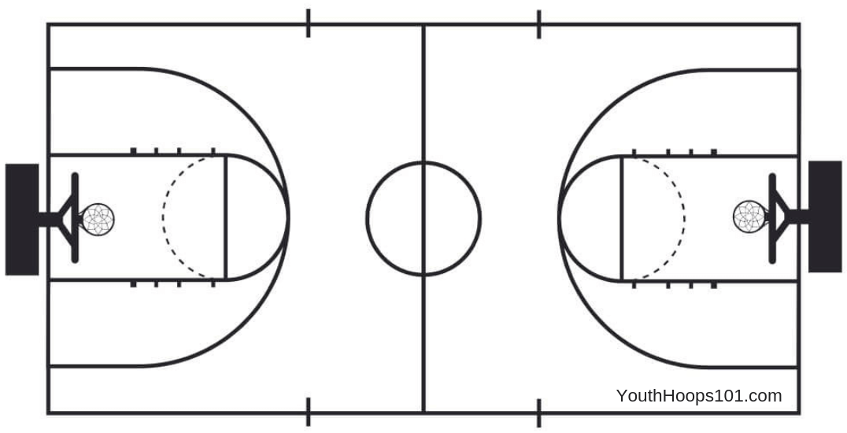
A classification example

Slide 13
Oh the places you can go!
Online
https://www.freecodecamp.org/learn/machine-learning-with-python/ (free, self-paced)
https://www.deeplearning.ai/courses/ (not free, but not crazy expensive, live instruction mostly)
https://developers.google.com/machine-learning/crash-course (highly Google-oriented, but good content)
https://www.udemy.com/courses/search/?q=machine+learning+python&src=sac&kw=machine+learning (tons of content, cheap when there’s a sale, quality varies)

Slide 14
Electronic dead trees
(Programmer focused) Aurélien Géron (2017), Hands-On Machine Learning with Scikit-Learn and TensorFlow: Concepts, Tools, and Techniques to Build Intelligent Systems, O’Reilly.
(Math focused, but free) Hastie, Tibshirani and Friedman (2009), The Elements of Statistical Learning, Springer. Textbook available online at: http://statweb.stanford.edu/~tibs/ElemStatLearn/printings/ESLII_print10.pdf
(Fun walkthrough of a DIY neural network) Rashid, Tariq (2016) Make Your Own Neural Network. https://www.amazon.com/Make-Your-Own-Neural-Network-ebook/dp/B01EER4Z4G/ref=sr_1_1?keywords=build+your+own+neural+network&qid=1656597202&sprefix=build+your+own+neural+%2Caps%2C210&sr=8-1

